Slide 1
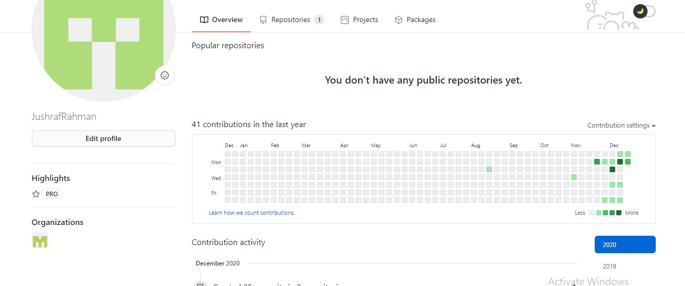
Fig: Commit Frequency

Slide 2
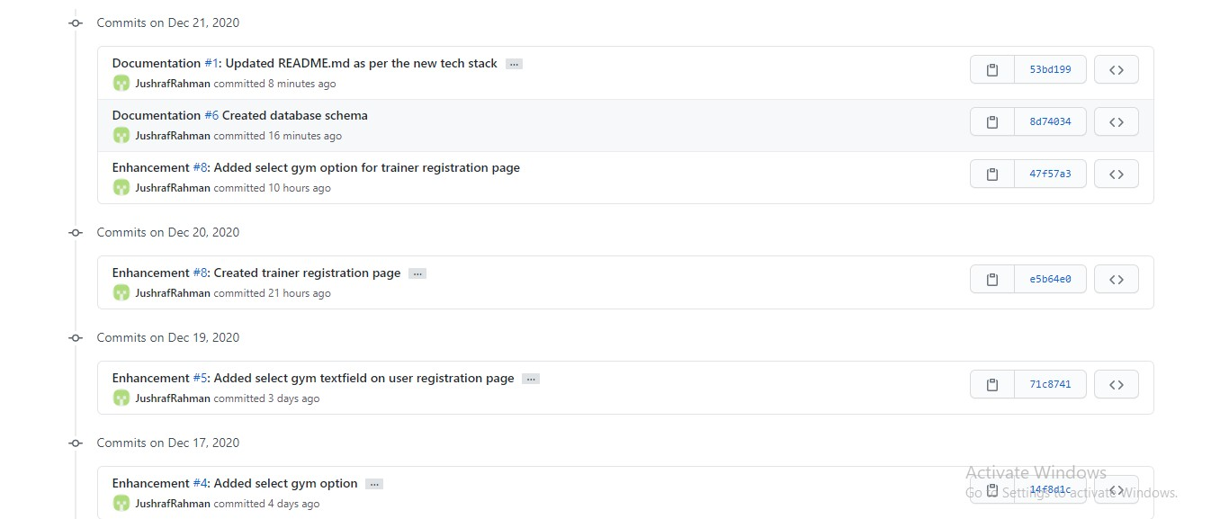
Fig: Commits this week

Slide 3
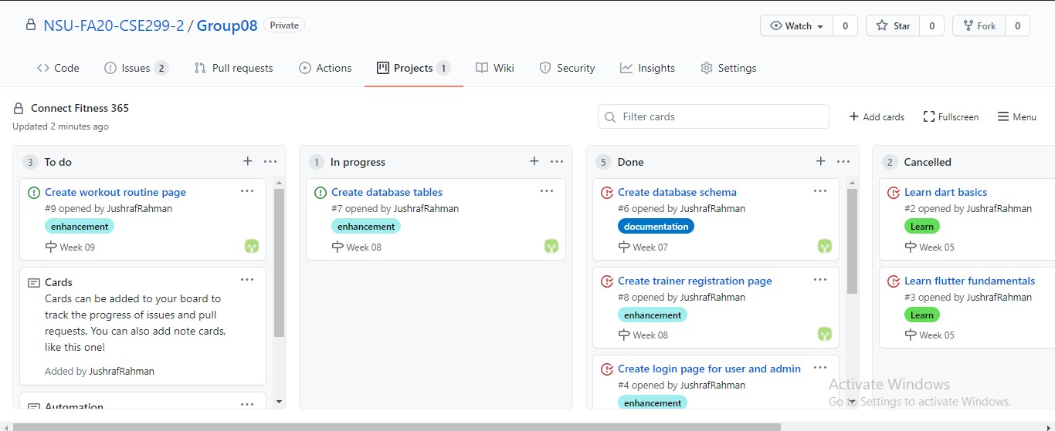
Fig: Issue Board

Slide 4
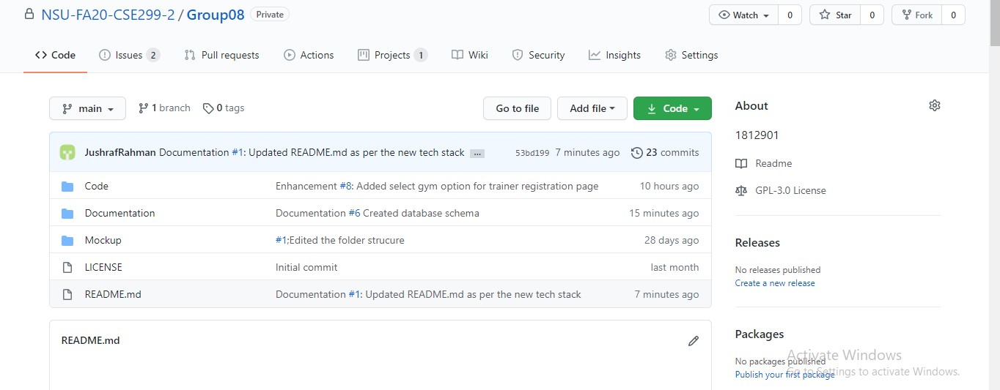
Fig: Home

